Slide 1
Computer Arithmetic
Notes:
We begin our examination of the processor with an overview of the arithmetic and
logic unit (ALU). The chapter then focuses on the most complex aspect of the ALU,
computer arithmetic. The logic functions that are part of the ALU are described in
Chapter 12, and implementations of simple logic and arithmetic functions in digital
logic are described in Chapter 11.
Computer arithmetic is commonly performed on two very different types of
numbers:
integer and floating point. In both cases, the representation chosen is a crucial
design issue and is treated first, followed by a discussion of arithmetic operations.
This chapter includes a number of examples, each of which is highlighted in a
shaded box.

Slide 2
Arithmetic & Logic Unit (ALU)
Part of the computer that actually performs arithmetic and logical operations on data
All of the other elements of the computer system are there mainly to bring data into the ALU for it to process and then to take the results back out
Based on the use of simple digital logic devices that can store binary digits and perform simple Boolean logic operations
Notes:
The ALU is that part of the computer that actually performs arithmetic and logical
operations on data. All of the other elements of the computer system—control unit,
registers, memory, I/O—are there mainly to bring data into the ALU for it to process
and then to take the results back out. We have, in a sense, reached the core or
essence of a computer when we consider the ALU.
An ALU and, indeed, all electronic components in the computer are based on
the use of simple digital logic devices that can store binary digits and perform simple
Boolean logic operations.

Slide 3
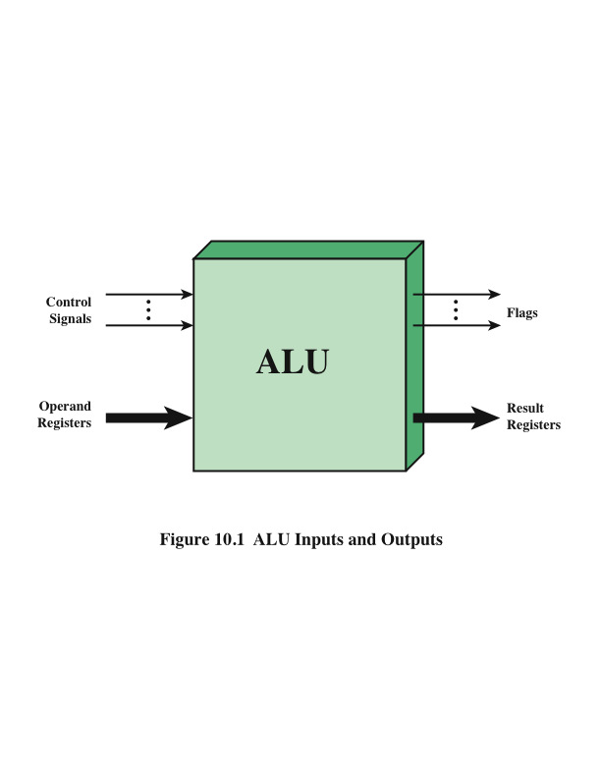
ALU Inputs and Outputs
Notes:
Figure 10.1 indicates, in general terms, how the ALU is interconnected with
the rest of the processor. Operands for arithmetic and logic operations are presented
to the ALU in registers, and the results of an operation are stored in registers.
These registers are temporary storage locations within the processor that are
connected by signal paths to the ALU (e.g., see Figure 2.3). The ALU may also set
flags as the result of an operation. For example, an overflow flag is set to 1 if the
result of a computation exceeds the length of the register into which it is to be stored.
The flag values are also stored in registers within the processor. The processor
provides signals that control the operation of the ALU and the movement of the
data into and out of the ALU.

Slide 4
Fixed-Point Representation
The radix point (binary point) is fixed and assumed to be to the right of the rightmost digit.

Slide 5
Integer Representation
In the binary number system arbitrary numbers can be represented with:
The digits zero and one
The minus sign (for negative numbers)
The period, or radix point (for numbers with a fractional component)
For purposes of computer storage and processing we do not have the benefit of special symbols for the minus sign and radix point
Only binary digits (0,1) may be used to represent numbers
Notes:
In the binary number system, arbitrary numbers can be represented with just the
digits zero and one, the minus sign (for negative numbers), and the period, or radix
point (for numbers with a fractional component).
For purposes of computer storage and processing, however, we do not have the benefit
of special symbols for the minus sign and radix point. Only binary digits (0 and 1)
may be used to represent numbers. If we are limited to nonnegative integers, the
representation is straightforward.

Slide 6
Sign-Magnitude Representation
There are several alternative conventions used to represent negative as well as positive integers
All of these alternatives involve treating the most significant (leftmost) bit in the word as a sign bit
If the sign bit is 0 the number is positive
If the sign bit is 1 the number is negative
Sign-magnitude representation is the simplest form that employs a sign bit
Drawbacks:
Addition and subtraction require a consideration of both the signs of the numbers and their relative magnitudes to carry out the required operation
There are two representations of 0
Because of these drawbacks, sign-magnitude representation is rarely used in implementing the integer portion of the ALU
Notes:
There are several alternative conventions used to represent negative as well as positive
integers, all of which involve treating the most significant (leftmost) bit in the
word as a sign bit. If the sign bit is 0, the number is positive; if the sign bit is 1, the
number is negative.
The simplest form of representation that employs a sign bit is the sign-magnitude
representation. In an n-bit word, the rightmost n - 1 bits hold the
magnitude of the integer.
There are several drawbacks to sign-magnitude representation. One is that addition
and subtraction require a consideration of both the signs of the numbers and their
relative magnitudes to carry out the required operation. This should become clear in the
discussion in Section 10.3. Another drawback is that there are two representations of 0:
This is inconvenient because it is slightly more difficult to test for 0 (an operation
performed frequently on computers) than if there were a single representation.
Because of these drawbacks, sign-magnitude representation is rarely used in
implementing the integer portion of the ALU. Instead, the most common scheme is
twos complement representation.

Slide 7
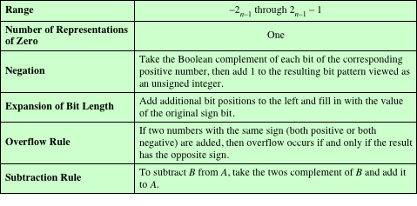
Twos Complement Representation
Uses the most significant bit as a sign bit
Differs from sign-magnitude representation in the way that the other bits are interpreted
Table 10.1 Characteristics of Twos Complement Representation and Arithmetic
Notes:
Like sign magnitude, twos complement representation uses the most significant bit
as a sign bit, making it easy to test whether an integer is positive or negative. It
differs
from the use of the sign-magnitude representation in the way that the other
bits are interpreted. Table 10.1 highlights key characteristics of twos complement
representation and arithmetic, which are elaborated in this section and the next.
Most treatments of twos complement representation focus on the rules for
producing negative numbers, with no formal proof that the scheme is valid. Instead,
our presentation of twos complement integers in this section and in Section 10.3 is
based on [DATT93], which suggests that twos complement representation is best
understood by defining it in terms of a weighted sum of bits, as we did previously
for unsigned and sign-magnitude representations. The advantage of this treatment
is that it does not leave any lingering doubt that the rules for arithmetic operations
in twos complement notation may not work for some special cases.

Slide 8
Range Extension
Range of numbers that can be expressed is extended by increasing the bit length
In sign-magnitude notation this is accomplished by moving the sign bit to the new leftmost position and fill in with zeros
This procedure will not work for twos complement negative integers
Rule is to move the sign bit to the new leftmost position and fill in with copies of the sign bit
For positive numbers, fill in with zeros, and for negative numbers, fill in with ones
This is called sign extension
Notes:
It is sometimes desirable to take an n-bit integer and store it in m bits, where m 7 n.
This expansion of bit length is referred to as range extension, because the range
of numbers that can be expressed is extended by increasing the bit length.
In sign-magnitude notation, this is easily accomplished: simply move the sign bit
to the new leftmost position and fill in with zeros.
This procedure will not work for twos complement negative integers.
Instead, the rule for twos complement integers is to move the sign bit to the
new leftmost position and fill in with copies of the sign bit. For positive numbers, fill
in with zeros, and for negative numbers, fill in with ones. This is called sign extension.

Slide 9
Negation
Twos complement operation
Take the Boolean complement of each bit of the integer (including the sign bit)
Treating the result as an unsigned binary integer, add 1
+18 = 00010010 (twos complement)
bitwise complement = 11101101
+ 1
11101110 = -18
-18 = 11101110 (twos complement)
bitwise complement = 00010001
+ 1
00010010 = +18
Notes:
In sign-magnitude representation, the rule for forming the negation of an integer is
simple: invert the sign bit. In twos complement notation, the negation of an integer
can be formed with the following rules:
1. Take the Boolean complement of each bit of the integer (including the sign
bit). That is, set each 1 to 0 and each 0 to 1.
2. Treating the result as an unsigned binary integer, add 1.
This two-step process is referred to as the twos complement operation, or the taking
of the twos complement of an integer.
As expected, the negative of the negative of that number is itself:

Slide 10
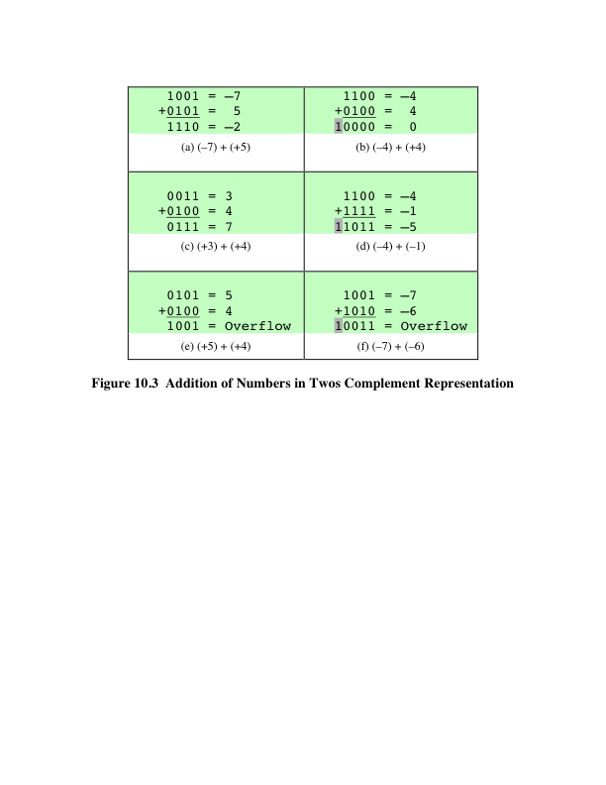
Addition
Notes:
Addition in twos complement is illustrated in Figure 10.3. Addition proceeds as if
the two numbers were unsigned integers. The first four examples illustrate successful
operations. If the result of the operation is positive, we get a positive number
in twos complement form, which is the same as in unsigned-integer form. If the
result of the operation is negative, we get a negative number in twos complement
form. Note that, in some instances, there is a carry bit beyond the end of the word
(indicated by shading), which is ignored.

Slide 11
Overflow
OVERFLOW RULE:
If two numbers are added, and they are both positive or both negative, then overflow occurs if and only if the result has the opposite sign.
Rule
Notes:
On any addition, the result may be larger than can be held in the word size
being used. This condition is called overflow. When overflow occurs, the ALU must
signal this fact so that no attempt is made to use the result.
Figures 10.3e and f show examples of overflow. Note that overflow can occur
whether or not there is a carry.

Slide 12
-103+ -69 = -172 (Overflow with carryout. Sum is not correct.)
104 + 45 = 149 (Overflow, no carryout. Sum is not correct.)
 | 1 | 1 |  | 1
 | 0 | 1 | 1 | 0 | 1 | 0 | 0 | 0
+ | 0 | 0 | 1 | 0 | 1 | 1 | 0 | 1
 | 1 | 0 | 0 | 1 | 0 | 1 | 0 | 1
1 |  | 1 | 1 | 1 |  | 1 | 1
 | 1 | 0 | 0 | 1 | 1 | 0 | 0 | 1
+ | 1 | 0 | 1 | 1 | 1 | 0 | 1 | 1
 | 0 | 1 | 0 | 1 | 0 | 1 | 0 | 0

Slide 13
Subtraction
SUBTRACTION RULE:
To subtract one number (subtrahend) from another (minuend), take the twos complement (negation) of the subtrahend and add it
to the minuend.
Rule
Notes:
Subtraction rule.

Slide 14
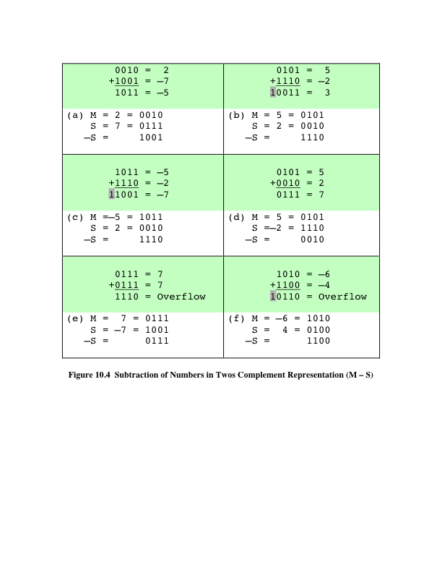
Subtraction
Notes:
Thus, subtraction is achieved using addition, as illustrated in Figure 10.4. The
last two examples demonstrate that the overflow rule still applies.

Slide 15
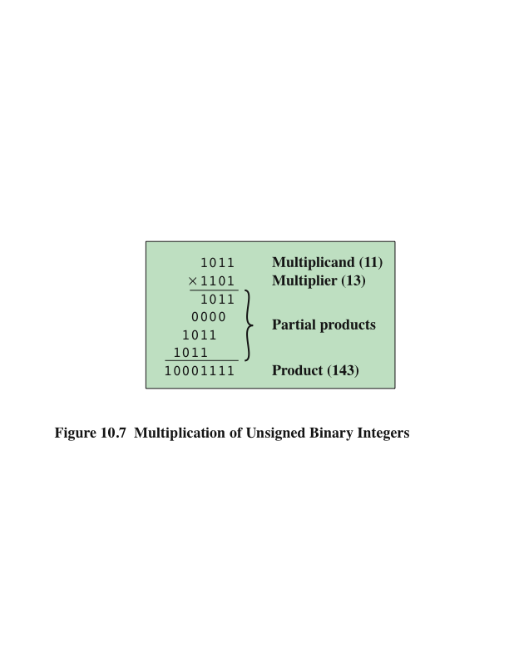
Multiplication
Notes:
Compared with addition and subtraction, multiplication is a complex operation,
whether performed in hardware or software. A wide variety of algorithms have been
used in various computers. The purpose of this subsection is to give the reader some
feel for the type of approach typically taken. We begin with the simpler problem of
multiplying two unsigned (nonnegative) integers, and then we look at one of the most
common techniques for multiplication of numbers in twos complement representation.
Figure 10.7 illustrates the multiplication of unsigned
binary integers, as might be carried out using paper and pencil. Several important
observations can be made:
1. Multiplication involves the generation of partial products, one for each digit in the
multiplier. These partial products are then summed to produce the final product.
2. The partial products are easily defined. When the multiplier bit is 0, the partial
product is 0. When the multiplier is 1, the partial product is the multiplicand.
3. The total product is produced by summing the partial products. For this operation,
each successive partial product is shifted one position to the left relative
to the preceding partial product.
4. The multiplication of two n-bit binary integers results in a product of up to 2n
bits in length (e.g., 11 * 11 = 1001).
Compared with the pencil-and-paper approach, there are several things we can
do to make computerized multiplication more efficient. First, we can perform a running
addition on the partial products rather than waiting until the end. This eliminates
the need for storage of all the partial products; fewer registers are needed. Second,
we can save some time on the generation of partial products. For each 1 on the multiplier,
an add and a shift operation are required; but for each 0, only a shift is required.

Slide 16
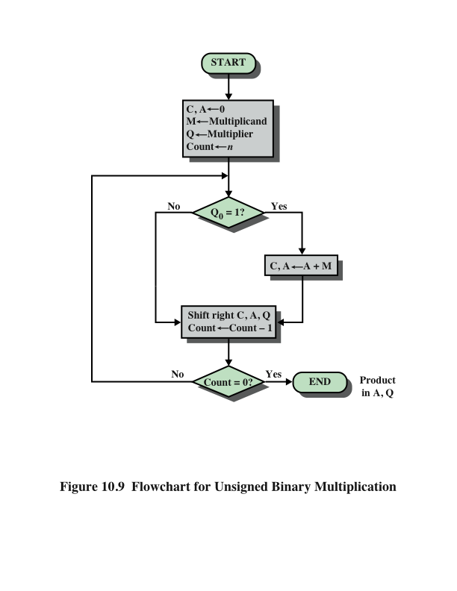
Flowchart for Unsigned Binary Multiplication
Notes:
The operation of the multiplier is as follows. Control logic reads the bits of the
multiplier one at a time. If Q₀ is 1, then the multiplicand is added to the A register
and the result is stored in the A register, with the C bit used for overflow. Then all
of the bits of the C, A, and Q registers are shifted to the right one bit, so that the C
bit goes into A_{n-1}, A₀ goes into Q_{n-1} and Q₀ is lost. If Q₀ is 0, then no addition is
performed, just the shift. This process is repeated for each bit of the original multiplier.
The resulting 2n-bit product is contained in the A and Q registers. A flowchart
of the operation is shown in Figure 10.9, and an example is given in Figure 10.8b.
Note that on the second cycle, when the multiplier bit is 0, there is no add operation.

Slide 17
Multiplication of 13 and 11

Slide 18
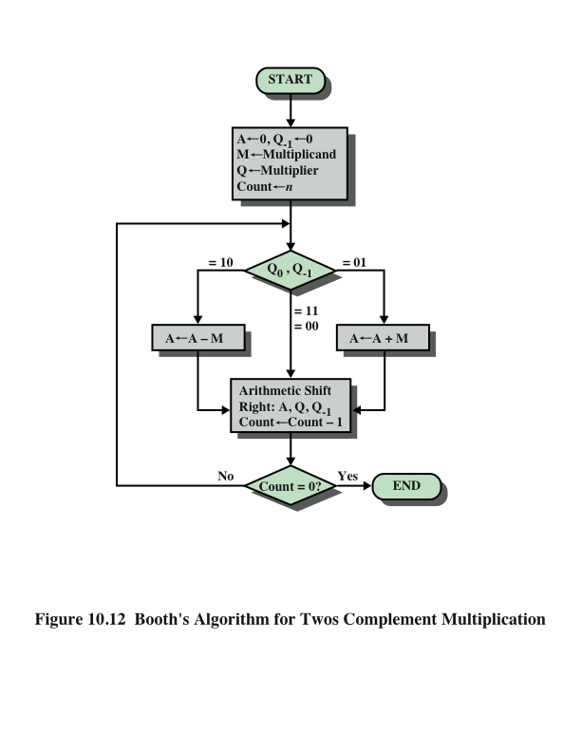
Booth’s
Algorithm
Notes:
Booth’s algorithm is depicted in Figure 10.12 and can be described as follows.
As before, the multiplier and multiplicand are placed in the Q and M registers,
respectively. There is also a 1-bit register placed logically to the right of the least
significant bit (Q₀) of the Q register and designated Q₋₁ its use is explained shortly.
The results of the multiplication will appear in the A and Q registers. A and Q₋₁
are initialized to 0. As before, control logic scans the bits of the multiplier one at a
time. Now, as each bit is examined, the bit to its right is also examined. If the two
bits are the same (1–1 or 0–0), then all of the bits of the A, Q, and Q₋₁ registers are
shifted to the right 1 bit. If the two bits differ, then the multiplicand is added to or
subtracted from the A register, depending on whether the two bits are 0–1 or 1–0.
Following the addition or subtraction, the right shift occurs. In either case, the right
shift is such that the leftmost bit of A, namely, A_{n-1} not only is shifted into A_{n-2},
but also remains in A_{n-1}. This is required to preserve the sign of the number in A
and Q. It is known as an arithmetic shift, because it preserves the sign bit.

Slide 19
Multiplication of 5 x -6, both represented in 4-bit 2’s complement notation.
A | Q | Q _{–1} | M
0000 | 1010 | 0 | 0101 | Initial
0000 | 0101 | 0 | 0101 | ASR | First Cycle
1011 | 0101 | 0 | 0101 | A ← A – M | Second Cycle
1101 | 1010 | 1 | 0101 | ASR
0010 | 1010 | 1 | 0101 | A ← A + M | Third Cycle
0001 | 0101 | 0 | 0101 | ASR
1100 | 0101 | 0 | 0101 | A ← A – M | Fourth Cycle
1110 | 0010 | 1 | 0101 | ASR

Slide 20
Division
More complex than multiplication
General principle is the same as multiplication.
Operation involves repetitive shifting and add/sub.

Slide 21
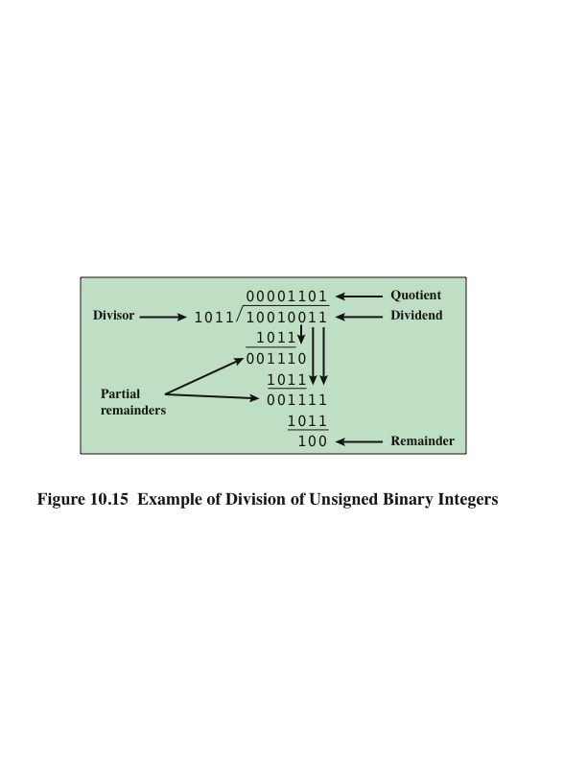
Division
Notes:
Division is somewhat more complex than multiplication but is based on the same
general principles. As before, the basis for the algorithm is the paper-and-pencil
approach, and the operation involves repetitive shifting and addition or subtraction.
Figure 10.15 shows an example of the long division of unsigned binary integers.
It is instructive to describe the process in detail. First, the bits of the dividend
are examined from left to right, until the set of bits examined represents a number
greater than or equal to the divisor; this is referred to as the divisor being able to
divide the number. Until this event occurs, 0s are placed in the quotient from left
to right. When the event occurs, a 1 is placed in the quotient and the divisor is subtracted
from the partial dividend. The result is referred to as a partial remainder.
From this point on, the division follows a cyclic pattern. At each cycle, additional
bits from the dividend are appended to the partial remainder until the result is
greater than or equal to the divisor. As before, the divisor is subtracted from this
number to produce a new partial remainder. The process continues until all the bits
of the dividend are exhausted.

Slide 22
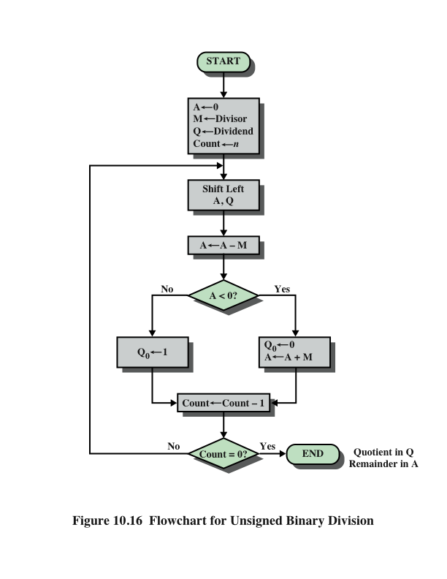
Flowchart for Unsigned Binary Division
Notes:
Figure 10.16 shows a machine algorithm that corresponds to the long division
process.

Slide 23
Two’s complement Division

Slide 24
Divide -7 ÷ 2
A | Q | M
1111 | 1001 | 0010 | Initial
1111 | 0010 | 0010 | Shift Left | First Cycle
0001 | 0010 | 0010 | A ← A + M, Sign of A changed
1111 | 0010 | 0010 | Restore A, Q₀ ←0
1110 | 0100 | 0010 | Shift Left | Second Cycle
0000 | 0100 | 0010 | A ← A + M, Sign of A changed
1110 | 0100 | 0010 | Restore A, Q₀ ←0
1100 | 1000 | 0010 | Shift Left | Third Cycle
1110 | 1000 | 0010 | A ← A + M, Sign of A unchanged
1110 | 1001 | 0010 | Q₀←1
1101 | 0010 | 0010 | Shift Left | Fourth cycle
1111 | 0010 | 0010 | A ← A + M, Sign of A unchanged
1111 | 0011 | 0010 | Q₀ ←1
Sign of dividend & divisor are different → negate Q
∴ Quotient = -Q =1101₂ = -3₁₀ ; Remainder = 1111₂ ₌ -1₁₀

Slide 25
Reference
Computer Organization and Architecture: Designing for Performance, William Stallings, 9th Edition, Pearson India, 2013.

